Slide 1
Type Clash in English Sentences
——an introduction to Asher’s
A Web of Words: Lexical Meaning in Context
Chern，2010/11/23
A Ph. D candidate in Department of Philosophy, Peking University

Slide 2
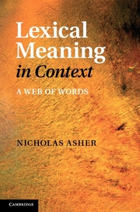
References
A Web of Words: Lexical Meaning in Context
Nicholas Asher
CNRS, Laboratoire IRIT, UMR 5505
Universit´e Paul Sabatier
Toulouse, France
and
Department of Philosophy
University of Texas at Austin
Not yet published
available from March 2011
The content in this talk can be find in chapter 1, 4 and 5.

Slide 3
What will be this talk about?
Introduction
The tool using in analyzing & Some phenomenon in English Language
How to understand a dot type (• type)
Summary & Questions

Slide 4
Introduction

Slide 5
Introduction
What is it to give the meaning of a word?
——picture? graph? so a lexical theory should be a theory of those pictures?
——given in terms of a set of primitives whose meaning can be axiomatized?
——the function of a lexical semantics is to specify the denotation of the various terms?

Slide 6
Introduction
Something in common:
at least consist in the specification of some element
combined in a certain way
in a well formed sentence
yields a meaning
in a particular discourse context

Slide 7
Introduction
Two principal tasks of a lexical theory
determine lexical meanings
furnish a theory of predication so that lexical meanings can combine together via predication to produce a logical form for a clause and ultimately a discourse.

Slide 8
The tool using in analyzing & Some phenomenon in English Language

Slide 9
tool
λ calculus
variables (and constants) as primitive terms together with the identity predicate = and an abstraction operator λ.
The set of terms is closed under the following rules:
if t is a term and v a variable, then λvt is also a term;
and if t and t₀ are terms then the application of t to t₀ is also a term t[t₀], and so is t = t₀.

Slide 10
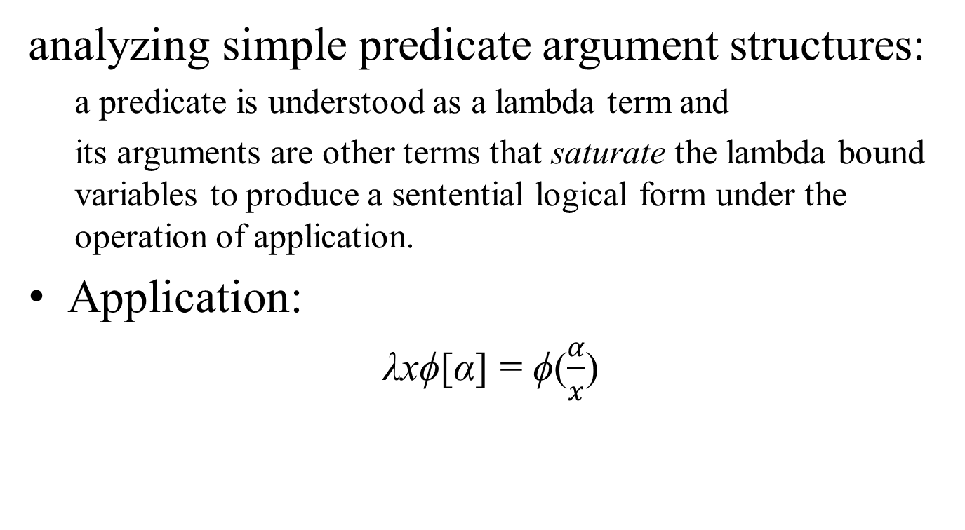
tool
analyzing simple predicate argument structures:
  a predicate is understood as a lambda term and
  its arguments are other terms that saturate the lambda bound variables to produce a sentential logical form under the operation of application.
Application:
λxϕ[α] = ϕ($\frac{α}{x}$)

Slide 11
Some phenomenon in English Language
Sometimes predications go wrong:
a. ?That person contains an interesting idea about Freud.
b. That person has an interesting idea about Freud.
c. That book contains an interesting idea about Freud.
d. That person is eating its breakfast.
e. That book is red.
f. #That rumor is red.
g. # The number two is red.
h. # The number two is soft.
i. The number two is prime.

Slide 12
Some phenomenon in English Language
f. #That rumor is red.
g. # The number two is red.
h. # The number two is soft.
f or g or h is malformed—category mistake: Numbers as abstract objects can’t have colors.
unless metaphorical understanding.
A theory of predication and a theory of lexical meaning should reflect these facts.

Slide 13
Some phenomenon in English Language
There are also degrees of category mistakes.
a. ?That person contains an interesting idea about Freud.
b. That person has an interesting idea about Freud.
c. That book contains an interesting idea about Freud.
d. That person is eating its breakfast.
In some sense people can contain information: spies have information that they give to their governments and that counter spies want to elicit; teachers have information that they impart to their students.

Slide 14
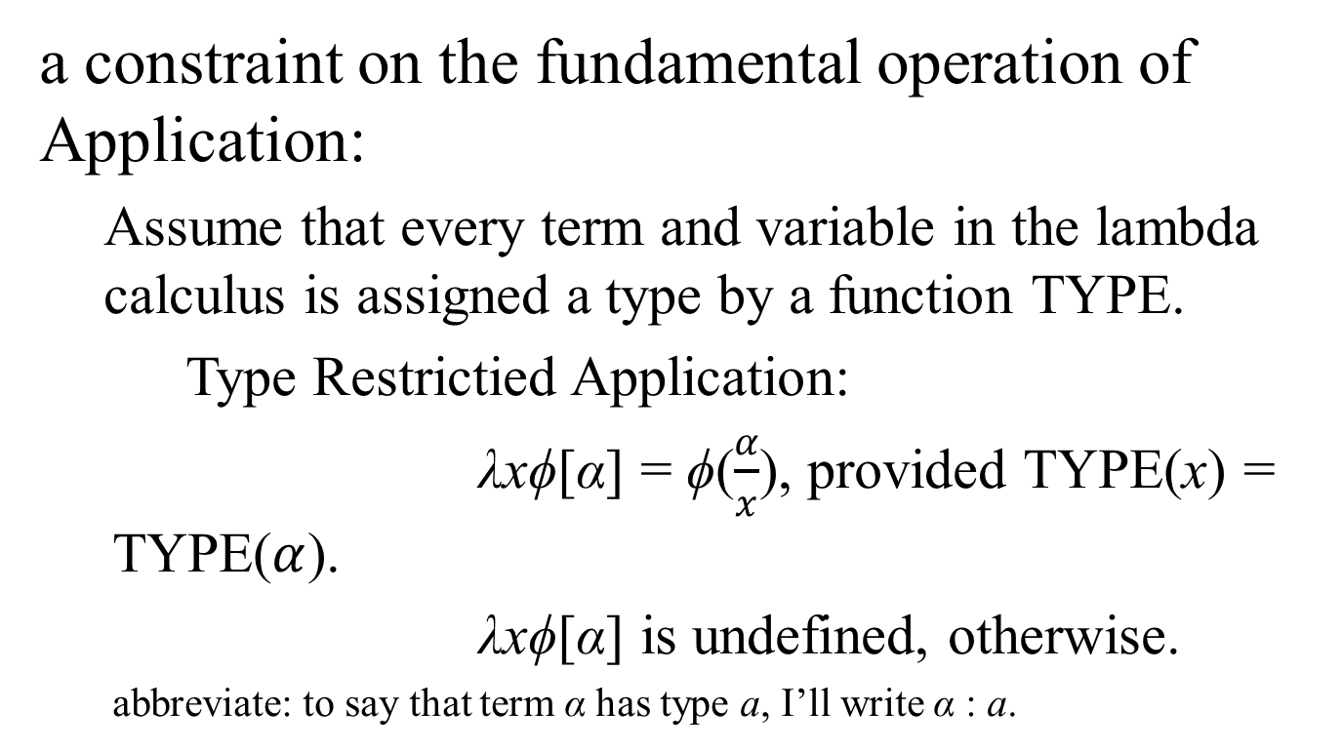
tool
a constraint on the fundamental operation of Application:
  Assume that every term and variable in the lambda calculus is assigned a type by a function TYPE.
  Type Restrictied Application:
  λxϕ[α] = ϕ($\frac{α}{x}$), provided TYPE(x) = TYPE($α$).
  λxϕ[α] is undefined, otherwise.
  abbreviate: to say that term α has type a, I’ll write α : a.

Slide 15
tool
Why Types?
Benefits
Observation from experiences

Slide 16
tool
Some Types:
EVENT TYPE: events, processes, states
NON-EVENT TYPE: objects
    John’s birth occurred at 10 am this morning.
    #John occurred at 10 am this morning.
    The tree grew slowly.
    ?The tree was slow.

Slide 17
tool
Other distinctions:
places (e.g., valley, field, river, mountain, hill),
objects (e.g., apple, glass, chair, car),
mixed objects (e.g., house, church, town, hall)
much water, much meat
#much person, #much people

Slide 18
tool
Inside events:
a. #John died for an hour.
b. John ran for an hour.
events vs. states:
a. #Samantha is knowing French.
b. Samantha is running.
c. Arnold is dying.

Slide 19
tool
Individual vs. kinds or species:
The Mexican fruit bat is common in this area.
Another type distinction involves containers and containables.
a. The water is inside the pitcher.
b. The keys are inside the car.
c. John put the keys inside his pocket/inside the drawer.
d. # John put the keys inside the air.
e. # John put the wine inside the water. versus: John put the wine in the water.

Slide 20
tool
Target of this book:
“…establish syntactic or lexical alternations to distinguish between types….there must be a linguistic construction that accepts expressions of one type but not the other.”

Slide 21
Some phenomenon in English Language
Compositionality:
The meaning of a sentence =
meaning of component₁+
meaning of component₂+
meaning of component₃+
……+
meaning of component_{n}
Provided that the sentence has n components.

Slide 22
Some phenomenon in English Language
Examples that are satisfying:
Aristotle is the teacher of Alexander.
The sky is blue.
NASA’s Chandra Finds Youngest Nearby Black Hole.
The morning star is the evening star.
…….

Slide 23
Some phenomenon in English Language
Examples that are not satisfying:
I’m parked out.
Lunch was delicious but took forever.
Nicholas enjoyed a cigarette.
John’s Mom burned the book on magic before he could master it.
……

Slide 24
Some phenomenon in English Language
Copredication:
Lunch was delicious but took forever.
The book has a purple cover and is the most intelligible introduction to category theory.

Slide 25
Some phenomenon in English Language
Types of the real arguments
Types of the argument requested by the predicates

Slide 26
Some phenomenon in English Language
A term with multi-types?

Slide 27
Some phenomenon in English Language
I’m parked out.
Lunch was delicious but took forever.
Nicholas enjoyed a cigarette.
John’s Mom burned the book on magic before he could master it.
There are type clashes in these sentences, which makes the meaning of the whole more than the sum of meanings of the part.

Slide 28
Some phenomenon in English Language
aspect selections
Lunch was delicious but took forever.
one predicate selects for the event sense of lunch while the other selects for the physical object or meal sense.

Slide 29
Some phenomenon in English Language
How can a term have two incompatible types, as is apparently the case here?
How can one term denote an object or set of objects to which apply two properties demanding different, even incompatible types of their bearers?

Slide 30
Some phenomenon in English Language
Traditional treatments:
ambiguous?
lunch₁, lunch₂…
then:
Lunch was delicious but lunch took forever.
similarly:
John gingerly tasted and then finished a lunch.
=> John gingerly tasted a lunch and then finished a lunch. ???

Slide 31
How to understand a dot type (• type)

Slide 32
How to understand a dot type
How to deal with dual aspect nouns?
books, lunches……
Different aspects vs. different conceptualization

Slide 33
How to understand a dot type
a. Mary picked up and mastered three books on mathematics. [physical object and informational content]
b. That is a lump of bronze but also Bernini’s most famous famous statue [portion of matter and artifact]
c. The lecture (interview, speech) lasted an hour and was very interesting. [event and information]
d. The exam was written in 10 minutes and was only 2 pages long but took 3 hours to complete [informational object and physical object and event]
The promise was made but impossible to keep. [speech act (event), proposition]

Slide 34
How to understand a dot type
f. Linnaeus’ classification of the species took 25 years and contains 12,100 species. [process and result]
g. ??John’s belief is false but persists
h. The house contains some lovely furniture and is just around the corner. [physical object and location]
i. Most cities that vote democratic passed anti-smoking legislation last year. [population and legislative entity]
j. Lunch was delicious but took forever. [food and event]
k. The apple has a funny color but is delicious. [food and surface or skin]

Slide 35
How to understand a dot type
Notation:
If t has an aspect of type a and an aspect of type b, then write it as t: a•b,
and call the type dot type.

Slide 36
How to understand a dot type
Not only nouns could have a dot type.
Example:
Could you pass the salt please?
Asher and Lascarides (2001) argue that:
please types its sentential argument as a request, syntax types the clause as a question,
this forces the discourse constituent introduced by example to have a complex type:
QUESTION •REQUEST.

Slide 37
How to understand a dot type
polysemous?
But dual aspect is distinct from the polysemous:
bank: the land alongside or sloping down to a river or lake;
a financial establishment that uses money deposited by customers for investment, pays it out when required, makes loans at interest, and exchanges currency

Slide 38
How to understand a dot type
traditional story about the data involving dual aspect nouns:
sense transfer
John picked up and mastered three books on mathematics.
books are physical objects but that they have associated with them an informational content.
Sometimes predicates apply to books properly speaking while some predicates apply to the associated informational content.
These cases, many argue, are examples of sense transfer.
Why should we need anything else?

Slide 39
How to understand a dot type
One objection:
sense transfer functions don’t tell us that there’sanything special about lunches, books and other elements that seem to have two constitutive types at once.
Real books have to exist in some physical form (even e books), but they also have to have some information content.

Slide 40
How to understand a dot type
Consider an example of sense transfer:
I’m parked out.
I => the vehicle I am driving.
Physical/informational aspects of books
vs.
I/a vehicle I am driving.
If sense transfer functions capture the latter, they fail to explain what’s special about books, lunches and other objects that are of • type.

Slide 41
How to understand a dot type
How to tell when a term is a dual aspect term.
  The linguistic test for such terms has two parts:
  first they must support copredications;
  secondly, predications that pick out a particular aspect of the objects associated with these terms must be able to affect the way such objects are counted or individuated.

Slide 42
How to understand a dot type
1 a. The student mastered every math book in the library.
b. The student carried off every math book in the library.
2 a. The teacher answered every student’s question.
b. The teacher repeated every student’s question.
3 a. John bought two newspapers yesterday. (physical object reading)
b. Rupert Murdoch bought two newspapers yesterday. (institution reading)

Slide 43
How to understand a dot type
4 a. Everyone is waiting to go home.
b. Everyone is parked out back.
5 a. John enjoyed many cigarettes last night.
b. John enjoyed no cigarettes last night.

Slide 44
How to understand a dot type
This second property of dual aspect terms is not shared by terms in standard sense transfer contexts.

Slide 45
How to understand a dot type
Is the differences between aspects the same as that between Types/Tokens?
  have to have a relational analysis of the token to the type；
  need to complicate our analysis of copredication in the same ways as we are presently dealing with aspects.

Slide 46
How to understand a dot type
Furthermore, there are cases where reference seems to be made to more objects than are available under a simple type/token analysis.
a. John hid every Beethoven 5th Concerto score in the library.
b. John mastered every Beethoven 5th Concerto score in the library

Slide 47
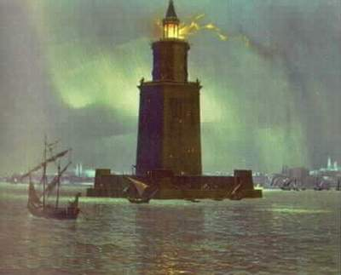
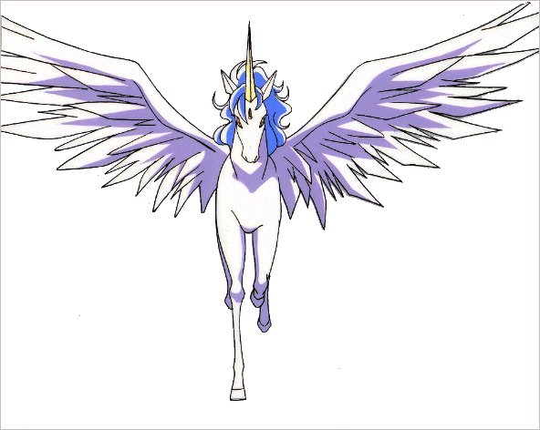
How to understand a dot type
How to choose the model?
Historical object’s type vs. Fictional type vs. Absurd type
The Lighthouse of Alexandria,
Pegasus, Unicorn?
Round Square

Slide 48
How to understand a dot type
The idea inside:
An object with type α•β is an object with at least two aspects, one is with type α, another is with type β.
Different type requesting predicates choose different aspects.

Slide 49
How to understand a dot type
•types are intersective or conjunctive types?
Conjunctive Types Axiom：
x: α⊓β iff x: α∧x: β
Provided that type hierarchy forms a complete lattice, then the greatest lower bound (abbreviate as glb) exists. Thus:
Conjunctive Types Hypothesis：
α•β ≔ α⊓β = glb{α, β}

Slide 50
How to understand a dot type
Why this conjunctive treatment fails?
The book is interesting but very heavy to lug around.
INFORMATIONAL OBJECT, use I for short
PHYSICAL OBJECT, use P for short
book: P •I

Slide 51
How to understand a dot type
Conjunctive Types Axiom：
x: α⊓β iff x: α∧x: β
Conjunctive Types Hypothesis：
α•β ≔ α⊓β = glb{α, β}
Provided that physical object has nothing in common with informational object, then
P•I = P⊓I = glb{P, I}= ⊥, ⊥ means absurd type.

Slide 52
How to understand a dot type
As for lunch:
Lunch consists of a meal, an object with parts (courses, dishes), and an event, the eating of the meal.
Objects: perdure through time;
Events: have a duration;
Objects: wholly present at each moment in time;
Events: have temporal parts.

Slide 53
How to understand a dot type
Another evidence for showing that events are disjoint from objects:
a. The tree grew slowly.
b. #The tree was slow.
c. The tree was slow in growing.
Thus, • types should not be thought as conjunctive types.

Slide 54
How to understand a dot type
Even if the glb is not ⊥, problems still exist.
a. The apple is red. skin
b. The apple is juicy (is delicious). food
SKIN ⊓ FOOD = SKIN
The skin of an apple is not what tastes delicious or is juicy.

Slide 55
How to understand a dot type
Another Model of • Types: Pair Types
Pair Types Hypothesis：
α•β ≔ (α, β)

Slide 56
How to understand a dot type
Suppose that on a shelf
  there are exactly two copies of War and Peace, two copies of Ulysses, and six copies of the Bible.
  Pat has read War and Peace and Ulysses, and no other book.
  Sandy has read the Bible, and no other book.
Now, consider
  (Q1) How many books are there on the shelf?
  (Q2) How many books has Pat read?
  (Q3) How many books has Sandy read?
  (Q4) Who has read more books, Pat or Sandy?
My guess is that most people would answer: ten to (Q1), two to (Q2), one to (Q3), Pat to (Q4)

Slide 57
How to understand a dot type
(1, W&P), (5, Bible), (9, Bible) (2, W&P), (6, Bible), (10, Bible), (3, Ul), (7, Bible) (4, Ul), (8, Bible)
To answer (Q2)-(Q4): the information contents, to counting how many books a person has read;
Counting the first components or whole pairs is relevant for answering (Q1), but not for (Q2)-(Q4).

Slide 58
How to understand a dot type
Copredications are not the problem for this model.
But this model does have a problem for simple predications.
The book weighs five pounds.
The predicate weighs five pounds requires that its argument be of PHYSICAL OBJECT or of P type.

Slide 59
How to understand a dot type
Suppose that the types P and I (the type of informational objects) are objects of a category. Then we can form the product type P × I to model the complex type of book.
Given categories P and I , we can define the morphisms for the product type
π₁: _{P×I} → _{P}
π₂: _{P×I} → _{I}
These morphisms adjust the type of a term like book so that its type matches up with the type of the predicate.

Slide 60
How to understand a dot type
Another problem:
Losing information
John’s Mom burned the book on magic before he could master it.
If we shift the book on magic to P so as to make the predication in the main clause of (5.4) succeed, then the anaphoric pronoun in the subordinate clause will not have an antecedent of an appropriate type.

Slide 61
How to understand a dot type
The crucial insight needed to solve this difficulty is that the projections from complex types to the constituent types go with different terms, not the original term.
So let’s in addition to our projections on pair types, let’s assume to function symbols f1 and f2 that give us new terms associated with t. Modifying the PTH (Pair Types Hypothesis) somewhat we could add the following axiom concerning these function symbols:

Slide 62
How to understand a dot type
Separate Terms Axiom (STA)：
t: α•β iff f₁(t): α∧f₂(t): β
The book weighs five pounds and is an interesting story.
∃!x(book(x)∧weighs five pounds( f₁(x))∧interesting story( f₂(x)),
<x : (P, I), f₁(x) : π₁((P, I)), f₂(x) : π₂((P, I))>

Slide 63
How to understand a dot type
Still a problem remains:
how do we count objects of complex types?
Can we count objects of complex type, where the constituent types provide two distinct criteria of indivudation, using both criteria of individuation？ In fact this yields absurd results.

Slide 64
How to understand a dot type
Let’s consider this example:
We have once again a shelf of books, where there are three copies of the Bible and one copy of Jane Austen’s collected works, which contains Pride and Prejudice, Emma, Mansfield Park, Sense and Sensibility, Persuasion, Northanger Abbey and Lady Susan.
The question is, how many books are there on the shelf?
Four, counting physical volumes,
but one might also answer ’eight’, using the informational type to individuate the domain.
Which of these will depend on context, certainly. But taking the pair types hypothesis as an ontological thesis—namely each pair of a distinct physical book and a distinct informational content constitutes a countable object—would yield the crazy count of 10 books.

Slide 65
How to understand a dot type
We can only count according to one coherent principle of counting.
We need to rexamine the functionality of aspects presupposed by STA. We need to determine whether functionality holds between books individuated informationally or physically and their physical and informational aspects.
Suppose we count books relative to the informational criterion. Then, as we’ve seen the relationship between books and physical aspects cannot be functional; one informational book may have several physical copies or aspects. On the other hand if we consider the Jane Austen case again, then we see that books individuated phyiscally may have multiple informational aspects.

Slide 66
How to understand a dot type
Functionality fails to hold.
a. The student mastered every math book in the library.
b. The student carried off every math book in the library.

Slide 67
How to understand a dot type
Parthood relation?
f_{i}(t) would be construed as a part of the semantic value of f ?
Normal parts of objects have names and can be referred to.
This isn’t true of the inhabitants of • types like lunches.

Slide 68
How to understand a dot type
Another problem in mereology:
Let =_{p} stand for the identity relation relative to an individuation criterion appropriate for physical objects and let =_{i} stand for the identity relation relative to the criterion appropriate for informational objects, for two copies of Bibles b₁ and b₂, we have:
a. b₁ =_{i} b₂
b. b₁ ≠_{p} b₂
In mereological terms, this implies that b₁ and b₂ have a common informational part but distinct physical parts. But then by the axioms of mereology, we have in terms of an absolute identity relation (in standard mereology two objects are equal just in case they have exactly the same parts):
b₁ ≠ b₂
Thus again in the example with the collected works of Jane Austen, we get the implausible count of 10 distinct objects!

Slide 69
How to understand a dot type
More problem with mereology:
A part of an object can exist alone without that object, while aspect cannot.
The leg of a desk exists even if the desk cracks.
But the physical or informational aspect of a book?

Slide 70
How to understand a dot type
Some objects of complex type α•β can be understood as mereological sums of objects of types α and β.
a. The apple was red and juicy.
b. The car is shiny and powerful.

Slide 71
How to understand a dot type
What is an aspect?
under a certain conceptualization.
An aspect is, metaphysically speaking, a bare particular combined with some property or some property instance that it has.
This is not a parthood relation over the object itself, for we need not consider the object to be the sum of all its aspects.
Given that we have defined aspects in a particular way, the sum of an object’s aspects cannot be identical to the object itself (since each aspect contains the object together with some property that it has).

Slide 72
How to understand a dot type
The proper model: pull back or fibre product
Definition Let C be a category and X, Y, Z ∈ C, with morphisms r : X → Z, t : Y → Z . The fibre product of X and Y over Z , denoted X ×_{Z} Y , is an object W ∈ C with two morphisms π₁ : W → X and π₂ : W → Y satisfying t○π₂ = r○π₁, such that for every V ∈ C and morphisms f : V → X and g : V → Y satisfying t○g = r○f , there exists a unique morphism u : V → W such that f =π₁○u and g =π₂○u.

Slide 73
How to understand a dot type
P×_{I}I
P
π₁
bible_{a}
p-bible_{a}
bible_{b}
p-bible_{b}
f
r = contained in
π₂
g
i-bible_{b}
t = identity
I
i-bible_{a}
i-bible_{a}
I

Slide 74
Summary & Questions

Slide 75
Summary
Summary:
Introduction
The tool using in analyzing & Some phenomenon in English Language
How to understand a dot type (• type)

Slide 76
Summary
How to understand a dot type (• type)
What is the dual aspect phenomenon?
  not ambiguous
  not polysemous
  not sense transfer
  not Type/Token distinct
What is the proper model?
  not conjunctive type
  not pair type
  not mereological sum
  the nature of aspect
  pull back, or fibre product

Slide 77
Questions
??
propostions
meaningful
true
false
nonsense
??

Slide 78

Questions
Q1: Are there any other dimensions we can add to divide the propositions?
Q2: How to make the current division more elegant?
Thanks for your patience!

