Slide 2
Introductions: to me, and Ω
Me
Me and Ω
Ω

Slide 3
Ω: preliminaries
Why “Ω”?
We’re told that Ω is the ultimate set of possible outcomes. But often in practice Ω is not that. It may be provisional, subject to revision. At best, it is “ultimate … for now!”
Ω is the final Greek letter, but it comes before P!
As such, Ω is consistent with other approaches to uncertainty …
Calling Ω the ‘sample space’ is a little odd.
‘Possibility space’ would be better.

Slide 4
Ω: preliminaries
Ω is a non-empty set. We have already made a theoretical commitment right there…

Slide 5
Ω: preliminaries
A set of what?
Possibilities, or outcomes—but which?
The answer will depend on our interpretation of P—subjective or objective.
I will be concerned here with subjective probability.

Slide 6
Ω and subjective probability
At a first stab, Ω’s possibilities are the objects of an agent’s uncertainty, which we want to regiment.
They will depend on whether we are thinking practically, or theoretically.
In practice, this is highly context-dependent and localized.
Typical examples: {H, T}, {1, 2, 3, 4, 5, 6}.

Slide 7
Ω and subjective probability
The possibilities are not jointly exhaustive. They don’t form a partition.
We could have extended the sets ‘sideways’, with more mutually exclusive possibilities.

Slide 8
Ω and subjective probability
The possibilities are not maximally specific.
We could have extended the sets ‘downwards’, with more refinements of the possibilities we have identified.

Slide 9
Ω and subjective probability
…
{ H , T }
{ H , T , edge }
SIDEWAYS INCOMPLETE
{ H & , H & , T & , T & }
Raining in Moscow
Not raining in Moscow
Raining in Moscow
Not raining in Moscow
…
DOWNWARDS INCOMPLETE

Slide 10
Ω and subjective probability
Adding alternatives sideways to a given possibility raises the question of whether it will occur; refining it downwards raises the question of how it will occur.
Our Ω will typically be incomplete, both sideways and downwards: the possibilities are not jointly exhaustive, and they are not maximally specific.
Sideways and downwards (in)completeness will figure centrally in the omega dilemma at the end.

Slide 11
Ω and subjective probability
Reasons to stop extending sideways:
We are ‘practically certain’ of the possibilities we already have—whatever that means.
We haven’t thought of any others.
We don’t care about any others.
In real life: we’re short of time, or of imagination.
Some possibilities might be too politically sensitive.

Slide 12
Ω and subjective probability
Reasons to stop extending downwards:
As before, but also: we can’t discriminate among the refinements. We wouldn’t know which one was realised.

Slide 13
Ω and subjective probability
At some point, we decide to stop our construction of Ω.
The proper stopping point is itself a decision problem.
Ironically, we use Bayesian decision theory to solve decision problems, but that theory presupposes that we have a probability space.
Here, the decision problem is: which probability space should we have? Do we solve that by moving to another probability space? Which? A regress threatens.

Slide 14
Ω and subjective probability
And we may be uncertain whether we have captured all of the possibilities that could matter to us. But how do we capture that uncertainty? In another probability space, whose elements are themselves probability spaces?

Slide 15
Ω and subjective probability
Having chosen an Ω, we may later want to revise it.

Slide 16
The choice of Ω
Two operations: formation, and revision. We construct an initial Ω, which we may later revise.
Unlike probabilities, one can rationally revise Ω without any evidence or learning—e.g. because one’s practical interests have changed, or the context has changed.

Slide 17
The choice of Ω
Or on the basis of evidence or learning, we might undergo a conceptual change, or even a scientific revolution, in which we need to represent new possibilities.
Bayesianism has a hard time representing this.

Slide 18
The choice of Ω
There is no structural guidance for the initial choice of Ω, the way there is for P…
Still less is there substantive guidance for choosing Ω—there is no analogue of the Principle of Indifference, or the Principal Principle.
That’s good news and bad news.
Good: there’s no such thing as an irrational choice of Ω by the lights of probability theory.
Bad: there’s no guidance for choosing well.

Slide 19
The choice of Ω
The identity of Ω is intimately connected with the arguments for probabilism and with these principles, which presuppose it.
Dutch Book arguments, accuracy, calibration arguments, etc. quantify over “all possibilities”…
But what are these possibilities?

Slide 20
The choice of Ω
The Principle of Indifference involves evidential symmetry across a set of possibilities. But what are the possibilities?
Regularity: if X is a non-empty set of possibilities, then P(X) > 0. But what are the possibilities?
The Principal Principle is stated in terms of “any reasonable initial credence function”. A constraint on such a function is that it be regular. Again, what are the possibilities over which regularity is assessed?

Slide 21
The choice of Ω
Similarly, there is no guidance for the revision of Ω.
On the contrary, Bayesianism typically assumes Ω is fixed throughout.
Indeed, the standard arguments for revision rules such as conditionalisation, imaging, minimum distance, etc. assume a fixed Ω…

Slide 22
The choice of Ω
So we’re on our own: we have to just choose an Ω.
I think we can do better: we can lay down some guidelines for desirable features of Ω, and some heuristics for coming up with an Ω that has those features, and for improving an Ω that we have.

Slide 23
How to argue that X is possible
There are many ways to argue that X is possible.
Two main forms of argument.

Slide 24
How to argue that X is possible
1. Begin with some other suitable property that X has, and infer that X is possible.

Slide 25
How to argue that X is possible
X is actually true
X has positive probability
or better still:
X is more probable than a contradiction (to allow for merely comparative probability, and irregularity)
X is conceivable
X corresponds to a point in a phase space that one of our best scientific theories countenances
¬X is arbitrary

Slide 26
How to argue that X is possible
¬X is unprovable
X has the form ‘V & not-W’, where there is an inference barrier between V and W.
‘No ought from an is’
Claims about the past and the future
Claims about what actually happens and probability claims

Slide 27
How to argue that X is possible
2. Begin with something else, Y, that is suitably related to X and possible, and infer that X is possible too. (Or perhaps two or more things, Y, Z ...)

Slide 28
How to argue that X is possible
Y entails X, where Y is possible
Y is compatible with X
Almost-X is possible
Extrapolation
Interpolation
Combinatorialism
Various physical transformations …

Slide 29
What should Ω be?
In one sense, the best possible Ω would have exactly one possibility, at the level of refinement that we care about: the actual possibility, the way things actually turn out (at that level)…
The trouble is, we don’t know the actual outcome in the cases of interest to us. (If we did, we would not be assigning probabilities!) This would not represent our uncertainty.

Slide 30
What should Ω be?
A necessary condition on a good Ω: the actual outcome is in it. Exactly one of Ω’s possibilities is realised.
But that puts pressure on us to expand Ω.
A natural thought is that it should be the set of all epistemic possibilities (for a given agent).

Slide 31
What should Ω be?
What is an “epistemic possibility” for an agent?
We could understand that various ways.
E.g., P is epistemically possible for the agent iff
P is compatible with what she knows.
She does not know that not-P.
She should not be certain that not-P…

Slide 32
What should Ω be?
Is another necessary condition on a good Ω that it not include epistemic impossibilities—possibilities that the agent has ruled out?
I think that’s wrong—maybe she is interested in counterfactuals about what would be the case, if such a possibility were to happen.
And it seems that we can have conditional probabilities that are defined even when the condition is epistemically impossible…

Slide 33
What should Ω be?
Since conditional probability is normally defined on a Cartesian product of subsets of Ω, it seems that Ω for conditional probability should be larger than just the collection of epistemic possibilities.
But it's normally assumed that the Ω’s for conditional probability and unconditional probability are the same. I question that.

Slide 34
What should Ω be?
Perhaps, then, Ω should be the collection of worlds, that needn't be epistemically possible, but that are merely entertainable by an agent?
Or given that agents like us can’t entertain an entire world, with all its detail, perhaps better still: Ω should be the collection of maximally fine-grained entertainable propositions.

Slide 35
What should Ω be?
There’s still an issue: “entertainable” is a modal notion—what is the operative modality? What set of possibilities does it generate?

Slide 36
Ω for ideal agents: ‘the set of all possible worlds’?
Philosophers often talk about expanding Ω all the way to ‘the set of all possible worlds’, especially when they are modelling ‘ideal agents’.
Here we leave behind practical considerations; now we are speaking entirely theoretically.
Then it sounds like Ω is chosen for us.
No wonder we’re given no guidance on choosing it!
And no wonder we’re given no guidance on revising it! It’s fixed, once and for all.

Slide 37
Ω for ideal agents: ‘the set of all possible worlds’?
Understood this way, the foundation of subjective Bayesianism is the same for all subjects, and thus seems to be entirely objective.
That may seem a little odd. Why aren’t the possibilities those over which a given agent is uncertain, as she represents them—a subjective Ω?
A fixed Ω seems reasonable for an objective probability function—e.g., the chance function—but less so for a subjective probability function.

Slide 38
Ω for ideal agents: ‘the set of all possible worlds’?
I’m sceptical about there being such a thing as the set of all possible worlds.
Kaplan’s paradox.
For each cardinal number K, it could be an epistemic possibility for an agent that there are K dogs.
Then we have proper class many such possibilities, because there are proper class many cardinal numbers.
We have a proper-class sized Omega. Omg!!

Slide 39
Ω for ideal agents: ‘the set of all possible worlds’?
Then we would need a new kind of probability theory, one that begins with proper classes rather than sets.
That seems like big news to me!

Slide 40
Ω for ideal agents: ‘the set of all possible worlds’?
For example, what are we to make of the (sigma) algebra, F?
It is supposed to be a set of subsets of Ω, that has Ω as a member, to which probabilities attach.
But if Ω is a proper class, it cannot be a member of anything.
What, then, do probabilities attach to?

Slide 41
Ω for ideal agents: ‘the set of all possible worlds’?
If Ω is constituted by all possible worlds, then it is sideways-complete, but it is a proper class rather than a set.
We need to rethink the mathematics of probability theory.

Slide 42
Ω for ideal agents: ‘the set of all possible worlds’?
This Ω is still not downwards-complete.
We could further refine the possible worlds into centred possible worlds, which mark a designated time and individual. Then, and only then, is Ω both sideways- and downwards-complete.
But this only exacerbates the cardinality worries: a given world now corresponds to many centred worlds…

Slide 43
Ω for ideal agents: ‘the set of all possible worlds’?
This brings us to the first horn of the omega dilemma:
If Ω is sideways- and downwards-complete, then it is a proper class. Then orthodox probability theory breaks down, and must be rethought.

Slide 44
Ω for ideal agents: ‘the set of all possible worlds’?
In any case, worlds, and even more so centred worlds, are too fine-grained for our practical purposes—they’re unnecessarily and intractably detailed.

Slide 45
Ω for agents more like us
We’re pulled in opposite directions: at the level of grain that we care about in our practical concerns, a small Ω is more tractable, easier to work with, but more likely to miss the actual outcome.
At one extreme, we have Ω is {the actual outcome}, but we don’t know when we have it.
At the other extreme, we have Ω is the class of all possible worlds, or even the class of all centred possible worlds—completely intractable!
Our practical situation is somewhere in between.

Slide 46
Ω for agents more like us
In practice, Ω should include the possibilities that we care about, but not ones that we don’t care about.
It should find the ‘sweet spot’ of being inclusive, but not too inclusive.

Slide 47
Ω for agents more like us
Here’s a rule for when you should refine Ω: do so whenever you have a preference between two different realisations of a given possibility.
Better still: refine Ω whenever it is an epistemic possibility for you that you have such a preference, or will have such a preference.
So our representation of uncertainty, our doxastic state, is to this extent bound up with our values, our desires—our bouletic state…

Slide 48
Ω for agents more like us
In practice, I think it’s best to overstock Ω first, so that the possibilities are in there to assess their value. We can later cull them if they make distinctions that don’t matter to us.

Slide 49
Ω for agents more like us
We enumerate some possibilities, but they run out before they exhaust all of logical space; or we run out of them because we are exhausted!
{heads, tails, edge, …}
or maybe
{heads, tails, edge, bird flies away with the coin, …}
So we might stop with the list we have, and hope for the best.
Then Ω is sideways-incomplete.

Slide 50
Ω for agents more like us
We might think of our probabilities as being conditional on one of the outcomes that we have enumerated having occurred.
But what if something not on that list happens?
Our conditional probabilities are undefined on such outcomes. How should we revise in that case?
If Ω is sideways-incomplete, then we have no account of how to update our credences and utilities when we encounter ‘black swans’—unforeseen possibilities.
We are unprepared for surprises.

Slide 51
Ω for agents more like us
There’s a popular way to sideways-complete Ωs...

Slide 52
Catch-alls
In various real-life problems (rather than artificial gambling problems), we often include a catch-all possibility that we cannot characterize positively: “none of these possibilities”, the ones that we do characterize positively…
E.g., {heads, tails, edge, bird flies away with the coin, CATCH-ALL}

Slide 53
Catch-alls
An Ω with a catch-all is always sideways-complete.
But it is downwards-incomplete: CATCH-ALL has no internal structure, and it does not distinguish many different possible outcomes.
Sometimes an event of greatest interest to us resides there - e.g. ‘black swans’.

Slide 54
Catch-alls
We may be able to refine the catch-all, discerning various more-specific possibilities contained within it.
e.g., {heads, tails, edge, bird flies away with the coin, dog runs away with the coin, CATCH-ALL #2}
This will have its limits: having done the best we can, there will remain part of the catch-all that we cannot characterize positively - the catch-all within the catch-all! ...
We keep iterating. And so it goes, indefinitely.
We never catch all in the catch-all!

Slide 55
Catch-alls
So we don’t pretend to positively characterize the entire catch-all.
But I think things are even worse than that for the set-theoretic approach.
We cannot catch the catch-all at all!

Slide 56
The catch-all: set-theoretic version
What exactly is the catch-all, when we do probability theory with sets?
It is the complement of the set of possibilities that we have identified so far.
But complementation is only defined relative to a universal set…
The whole point is that in practice, we don’t have Ω in the first place—we are constructing it.

Slide 57
The catch-all: set-theoretic version
Start with Ω = {ω₁, ω₂, … }
Then add the catch-all:
Ω = {ω₁, ω₂, …, CATCH-ALL}
But what is that? Let’s spell it out:
Ω = {ω₁, ω₂, …, Ω – {ω₁, ω₂, …, }}
Whoops!
Again, it’s an axiom that P(Ω) = 1. But what exactly are we attaching probability 1 to?

Slide 58
P

Slide 59
~P

Slide 60
f
P

Slide 61
~P?

Slide 62
The catch-all: sentential version
“How can it be so hard to define the catch-all? Just take the disjunction of all of the events that you have identified so far, and negate that!”
This may bring out an unappreciated difference between the set-theoretic and the sentential formulations of probability theory.

Slide 63
The catch-all: sentential version
Negation is easy: it is just a one-place operator: start with sentence S, and generate not-S.
But complementation is more complicated: it is a two-place operator, needing two operands: set S and the universal set (with respect to which the complementation is taken).
But the whole point is that we don’t have that universal set—we’re building it.

Slide 64
The catch-all: sentential version
So much for the received view that the set-theoretic and sentential formulations of probability theory are equivalent/interchangeable!
They can’t be, because a problem that arises for one doesn’t arise for the other.

Slide 65
The catch-all: sentential version
So things seem to be looking more promising for Ω, at least for practical purposes: we formulate it sententially, and sideways-complete it with a catch-all.
But still there are problems...

Slide 66
The catch-all: sentential version
It may be difficult in practice to assign a probability to the catch-all…
Yet when we are forecasting extreme events, the events that constitute the catch-all may especially deserve our attention!
Psychological studies show that we tend to underestimate the probability of the catch-all.
There’s also a problem with assigning expected utility to the catch-all…

Slide 67
The catch-all: sentential version
What happens if the actual outcome lands in the catch-all?
We might say: “the experiment was not performed”.
That might be fine for artificial cases, like coin and die tosses.
But what about real life? Something happened.

Slide 68
The catch-all: sentential version
How are we to revise our probabilities if we learn that the actual outcome falls in the catch-all?
We won’t settle on just the trivial assignment of 1 to what was previously the catch-all, 0 elsewhere.
We learn the particular way in which the catch-all is realised.
We will form various credences for more specific propositions.
We saw a version of this problem when Ω was sideways-incomplete.

Slide 69
The catch-all: sentential version
Incompleteness in either direction exposes us to learning things that are not in Ω.
We need an account of how we should revise our credences when this happens.

Slide 70
The catch-all: sentential version
We can now complete our omega dilemma:
If Ω is sideways and downwards complete, then it is a proper class. Then orthodox probability theory breaks down, and must be rethought.
If Ω is incomplete (either sideways or downwards), then we need an account of how probabilities should be revised when a proposition that is not in Ω is learned.

Slide 71
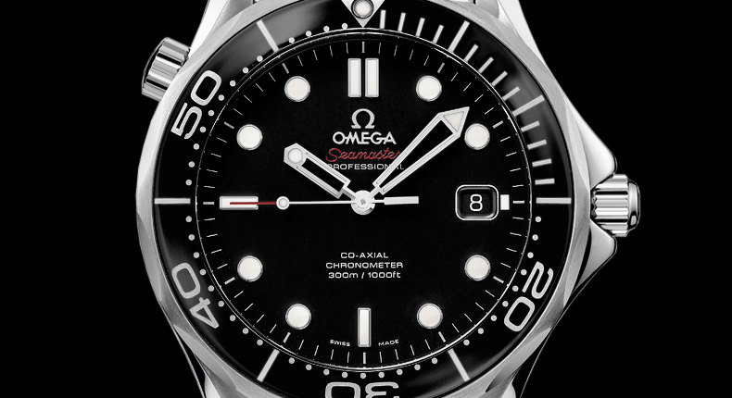

Slide 72
Thanks
With thanks especially to: David Builes, Catrin Campbell-Moore, John Cusbert, Nick DiBella, Ed Elliott, Leon Leontyev, Aidan Lyon, Wlodek Rabinowicz, Miriam Schoenfield, Wolfgang Schwarz, Michael Smithson, and Katie Steele.

Slide 74
Consider extreme possibilities
Consider extreme possibilities …
Ex. What would be the worst way for foot-and-mouth disease to enter Australia? Or the best way?

Slide 75
Consider extreme possibilities
Also consider near-extreme possibilities.
They may be more realistic.

Slide 76
Magnetic Philosophy
Begin with a topic of interest to you.
Write down all the keywords you can think of on this topic on separate pieces of paper; you can even paste them onto fridge magnets.
Then rearrange them in various ways, juxtaposing pairs, triples, and so on.

Slide 77
Magnetic Philosophy
Coming up with the fridge words
Add more generic words to the mix
Import from other areas
Randomise
Crowd-source
Be funny!

Slide 78
Add constraints
Add constraints!
Desiderata
Restricted concepts and vocabulary
Computational constraints

Slide 79
Taxonomise and colonise
When approaching a topic, draw up a table of cross-cutting distinctions, ways of categorizing the things in the relevant domain;
fill in the boxes with existing views;
look for empty boxes;
then try to fill them with new views that meet their constraints. If there are no empty boxes, try finer-grained distinctions, and repeat.

Slide 80
Taxonomise and colonise
Putative justifications→ Putative norms↓ | Dutch book | Accuracy | Representation theorem | Maximal entropy | Minimal distance | …
Probabilism | ✔ | ✔ | ✔
Regularity | ✔
Principal Principle | ✔ | ✔
Reflection Principle | ✔ | ✔
Indifference Principle |  | ✔ |  | ✔
Conditionalization | ✔ | ✔ |  |  | ✔
Jeffrey Conditionalization | ✔ |  |  |  | ✔
…

Slide 81
Good notation
Good notation can help with taxonomising possibilities.

Slide 82
Good terminology
Relatedly, good terminology has heuristic value.
Don’t get me started on all the bad terminology in probability theory!

Slide 83
Some ways to argue that X is possible
Two main forms of argument:
1. Begin with some other suitable property that X has, and infer that X is possible.
2. Begin with something else, Y, that is suitably related to X and possible, and infer that X is possible too.
(Or perhaps two or more things, Y, Z ...)

Slide 84
Some ways to argue that X is possible
1.i. Argue that X is actual.

Slide 85
Some ways to argue that X is possible
1.ii. Positive probability
X has positive probability
∴X is possible

Slide 86
Some ways to argue that X is possible
1.ii. Positive probability
X has positive probability
∴X is possible
Different senses of ‘probability’ will yield different senses of ‘possibility’.

Slide 87
Some ways to argue that X is possible
1.ii. Positive probability
X has positive probability
∴X is possible
Different senses of ‘probability’ will yield different senses of ‘possibility’.
Good for philosophy; not so good for Ω!

Slide 88
Some ways to argue that X is possible
1.iii. Arbitrariness
Where there is arbitrariness, things could have gone differently. So if ¬X is arbitrary, X is possible. (Lewis)

Slide 89
Some ways to argue that X is possible
1.iii. Conceivability
X is conceivable
∴X is possible

Slide 90
Some ways to argue that X is possible
1.iv. Phase space
X corresponds to a point in a phase space that our best scientific theories countenance
∴X is possible

Slide 91
Some ways to argue that X is possible
1.v. Arbitrariness
Where there is arbitrariness, things could have gone differently. So if ¬X is arbitrary, X is possible. (Lewis)
(For Leibniz, arbitrariness involves a violation of the Principle of Sufficient Reason, and he used it to eliminate possibilities!)

Slide 92
Some ways to argue that X is possible
2.i. Almost-X
1. Argue: almost-X is possible
2. Argue: the small difference between almost-X and X does not make any difference to possibility.
∴ X is possible.

Slide 93
Some ways to argue that X is possible
2.ii. Extrapolation
Begin with a clear case of possibility, and work by small steps to X.

Slide 94
Some ways to argue that X is possible
2.iii. Interpolation
Show that W and Y are each possible, and that X falls ‘between’ W and Y on some relevant axis, or with respect to some gradable property.
Hume’s missing shade of blue

Slide 95
Some ways to argue that X is possible
2.iv. Combinatorialism
Let X be the result of taking any things that are separately possible, and putting them together in any arrangement permitted by shape and size. Then X is possible.

Slide 96
Some ways to argue that X is possible
2.iv. Combinatorialism
This fits well with the fridge magnets.
It is possible for a pub to sit on the top of Mt Everest

Slide 98
Some ways to argue that X is possible
2.v. Symmetry principles of physics
Physics has various symmetry principles according to which the laws of nature are preserved under various transformations.
Starting with a physically possible scenario, apply one of these transformations.

Slide 99
Some ways to argue that X is possible
E.g. take a scenario that is physically possible, time-reverse it, and you get another scenario that is physically possible.

Slide 100
Some ways to argue that X is possible
More generally, symmetries are often good possibility-generators: if w is possible, then so is anything related to w by suitable symmetry-based transformations—e.g. translations, rotations, reflections.

Slide 101
Negative spaces

Slide 102
Negative spaces

Slide 103
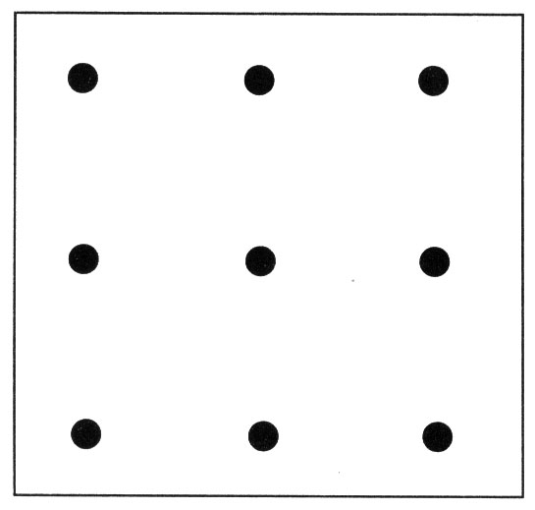
Negative spaces

Slide 104
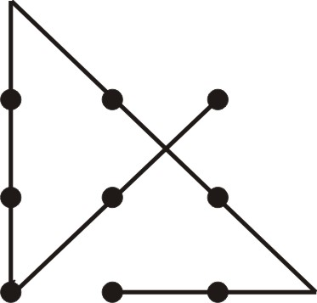
Negative spaces

Slide 105
Negative spaces

Slide 106
Negative spaces

Slide 107
Negative spaces

Slide 108
Negative space of possibilities that we have
We don’t think enough about the negative space of the possibilities that we have put in omega.

Slide 109
Negative space of possibilities that we have
We might think of our probabilities as really being conditional on one of the outcomes that we have enumerated having occurred. (Perhaps these are primitive conditional probabilities.) But what if something not on that list happens? Our conditional probabilities are undefined on such outcomes. How should we revise in that case?

Slide 110
Sideways incompleteness and surprises
Troubling punchline #2:
If Ω is sideways-incomplete, then we have no account of how to update when we encounter ‘black swans’—unforeseen possibilities. We are unprepared for surprises.

Slide 111
Catch-alls
In various real-life problems (rather than artificial gambling problems), we often include a catch-all possibility that we cannot characterize positively: “none of these possibilities”, the ones that we do characterize positively. We say “none of the above”, “other”, “something else”.
The catch-all always fills in sideways.

Slide 112
Catch-alls
But what exactly is the catch-all, when we do probability theory with sets?

Slide 113
Catch-alls
We start with:
Ω = {w₁, w₂, … }
Then we add the catch-all:
Ω = {w₁, w₂, …, CATCH-ALL}
But what is that? Let’s spell it out:
Ω = {w₁, w₂, …, Ω – {w₁, w₂, …, }}
Whoops!

Slide 114
An omega trilemma
Putting together our disturbing punchlines:
If Ω is constituted by all possible worlds, then it is complete (both sideways and downwards), but it is a proper class rather than a set. We need to rethink the mathematics of probability theory.
If Ω is sideways-incomplete, then we have no account of how to update when we encounter ‘black swans’—unforeseen possibilities. We are unprepared for surprises.
If we claim to complete Ω with a catch-all (thus catching surprises), then it is unclear what the catch-all is—it is ill-defined.

Slide 115
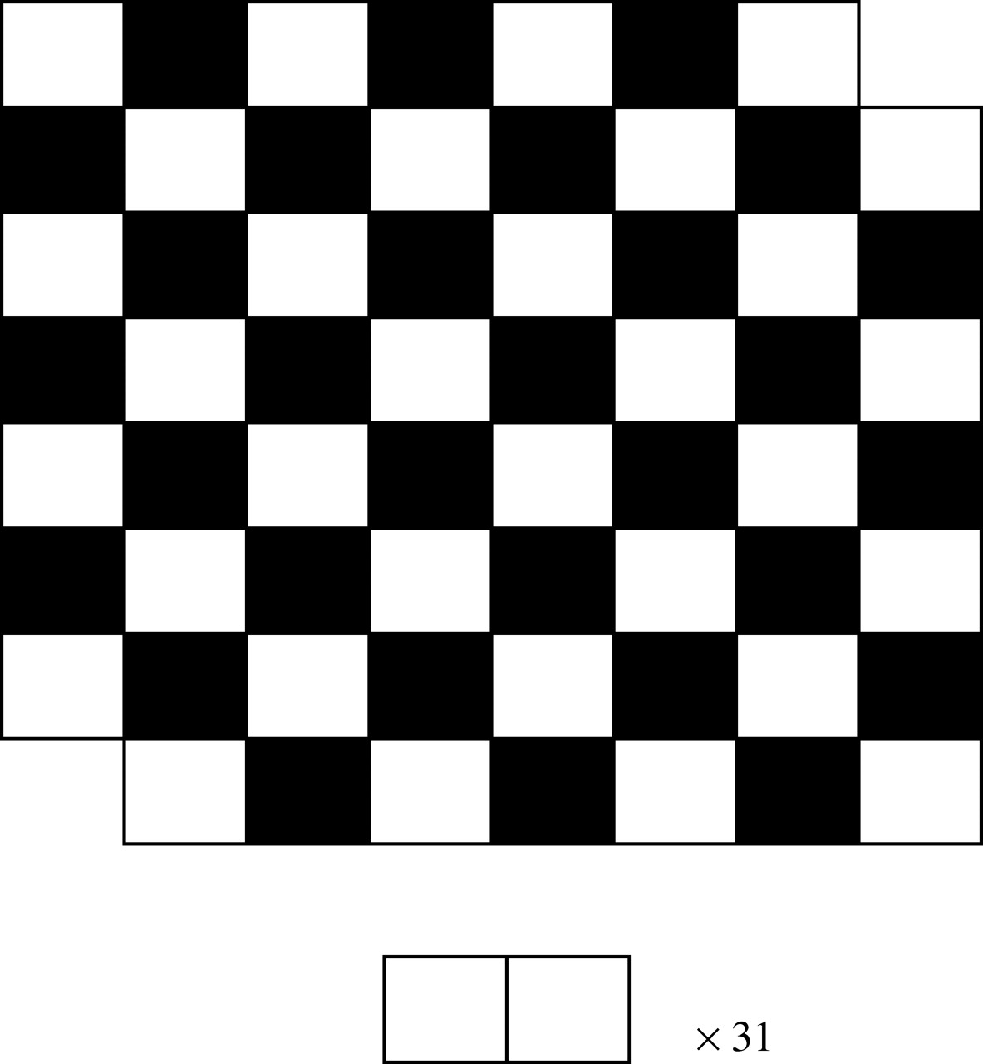
Negative space

Slide 116
Negative space
Ned Hall, "The Intrinsic Character of Causation”, considers 'the presence of enabling factors', but also in his discussion of double prevention he discusses 'the absence of disabling factors'.
As well as thinking causing a disease directly, think of the preventing a prevention of a disease …

Slide 117
Some topics for future research
Problems with the catch-all expanding Ω sideways.
There are problems with refinements, too.
Simpson’s paradox
Causal modeling
The reference class problem

Slide 118
Some topics for future research
Interactions between omega and probabilities/decisions
Dominance
Independence
Principle of indifference

Slide 119
Multiple perspectives

Slide 121
Multiple perspectives
Look at the same problem from multiple perspectives.
Different angles; turn upside down.
Reflect, translate, rotate, apply other transformations, think about the result.
Level shift (big picture vs close detail: wood, trees)
Again, imagine you’re someone with a different world-view to yours

Slide 122
Multiple perspectives
Suppose you believe p, or argue for p. Try to argue for not-p.
Work backwards:
Do a ‘pre-mortem’.
Or visualize success, and work backwards to figure out how to achieve it.

Slide 123
Multiple perspectives
Chess: look at files, ranks, diagonals, colours of occupied squares, what has changed.
Look ‘negatively’: Empty squares – absence of pieces. What has weakened? It’s obvious which attacks have been gained. Less obvious: which attacks have been lost? Which protections have been lost?

Slide 124
About 𝛀
The ‘choice’ of Ω
What makes a good Ω, or one Ω better than another one?

Slide 125
Check extreme cases
‘Check extreme cases’ is a good heuristic, three times over:
It is often easy to use. Extreme cases of the relevant kind are often easily identified.
It is fertile. Extreme cases are often troublesome in virtue of being extreme—that is, sometimes problems that could not arise in normal cases can arise at the extremes.
We are liable to forget or miss extreme cases, since we tend to live our lives in the thick of normal cases.

Slide 126
About 𝛀
Why “Ω”?

Slide 127
About 𝛀
Ω is a non-empty set. A set of what? Possibilities, or outcomes—the objects of our uncertainty. But which?
This is highly context-dependent. Typical examples:
{H, T}, {1, 2, 3, 4, 5, 6}
They are not jointly exhaustive.
They are not maximally specific.

Slide 128
About 𝛀
Before we get to the probabilities, we have a kind of ‘practical certainty’ regarding the elements of Ω: The actual outcome will be one of these.

Slide 129
About 𝛀
Before we get to the probabilities, we have a kind of ‘practical certainty’ regarding the elements of Ω: the actual outcome will be one of these.

Slide 130
About 𝛀
Reasons to stop extending sideways (itself a decision problem):
We’re practically certain of the possibilities we already have.
We haven’t thought of any others.
We don’t care about any others.
In real life: we’re short of time.
Some possibilities might be too politically sensitive.

Slide 131
About 𝛀
Before we get to the probabilities, we have a kind of ‘practical certainty’ regarding the elements of Ω: The actual outcome will be one of these.

Slide 132
About 𝛀
So at some point we decide to stop our construction of Ω. The proper stopping point is itself a decision problem.
We often use Bayesian decision theory to solve decision problems, but that theory presupposes that we have a probability space.
Here, the decision problem is: what probability space should we have? Do we solve that by moving to another probability space? Which? A regress threatens.

Slide 133
About 𝛀
Before we get to the probabilities, we have a kind of ‘practical certainty’ regarding the elements of Ω: The actual outcome will be one of these.

Slide 134
Contrastive stress
‘Taxonomise and colonise’ relies on making distinctions. Distinctions presuppose contrasts: this, rather than that.
Mentally highlight each word or phrase in a question or statement, and even intone the words “rather than” or “as opposed to”, followed by members of the contrast class.
Doing so encourages your mind to consider alternatives to the highlighted word or phrase.

Slide 135
Turn the knobs
Key terms in a thesis or argument will often involve variables that can take a number of values; mentally run through their values.

Slide 136
Probability Without Greek Letters
We start with an ultimate set of possibilities, ‘Ω’.
But instead we could use ‘W’, suggestive of ‘Worlds’.
The second axiom becomes “P(W) = 1”.

Slide 137
Probability Without Greek Letters
In simple cases, where the basic outcomes all get equal weight, probabilities are a matter of counting—think of a fair die.
But we want to generalise to cases where the outcomes have unequal weight. We then add up their weights, by the additivity axiom.

Slide 138
Probability Without Greek Letters
The letter “Σ” is used to symbolise summing.
is shorthand for:
1 + 2 + 3.
Replace ‘j’ by each of its values, and add!

Slide 139
Probability Without Greek Letters
is shorthand for:
1 + 2 + … + n.

Slide 140
Probability Without Greek Letters
In the law of total probability:
the right-hand side is shorthand for:
P(A |B₁)P(B₁) + P(A |B₂)P(B₂) + … + P(A |B_{n})P(B_{n})

Slide 141
Independence
If P(A and B) = P(A)P(B), then A and B are said to be independent
Assuming that P(B) > 0, this is equivalent to P(A | B) = P(A)
Similarly, if P(A) > 0, A and B are independent just in case P(B | A) = P(B)

Slide 142
Correlation
If P(A and B) ≠ P(A)P(B),
then A and B are said to be dependent or correlated.

Slide 143
Correlation
If P(A and B) ≠ P(A)P(B),
then A and B are said to be dependent or correlated.
We will also speak of variables, corresponding to events, being correlated.

Slide 144
Correlation
Example:
There is a correlation between being Australian and getting a medal for swimming at the Olympics.
A = the event of a given person being Australian.
B = the event of that person winning a medal for swimming.

Slide 145
Correlation
We could also think of ‘being Australian’ as a variable that takes two values (say, 0 and 1); likewise winning a medal.

Slide 146
Correlation
The notion of the correlation between variables generalises to variables that take many values, but we won’t get into the technical details here.
Roughly, the idea is that the correlation between two variables is a measure of the extent to which their values rise and/or fall in synch with one another.

Slide 147
Correlation
There is also a correlation between coming from Kazakhstan and getting a medal for swimming at the Olympics.

Slide 148
Correlation
If P(A and B) > P(A)P(B), then A and B are said to be positively correlated.
A = the event of a given person being Australian.
B = the event of that person winning a medal for swimming.
If P(A and B) < P(A)P(B), then A and B are said to be negatively correlated.
A = the event of a given person coming from Kazakhstan.
B = the event of that person winning a medal for swimming.

Slide 149
Correlation
If A and B are positively (negatively) correlated, then we say that each event is evidence for (against) the other, and that each event confirms (disconfirms) the other.

Slide 150
Conditional Independence and Correlation
We can also extend the notions of independence and correlation to probabilities conditional on some event C
If P(A and B | C) = P(A | C)P(B | C),
then A and B are said to be independent, conditional on C
If P(A and B | E) > P(A | E)P(B|E),
then A and B are said to be positively correlated conditional on E
Reverse the inequality for their being negatively correlated conditional on E

Slide 151
Correlation is not causation!
People often say that there are three possible explanations for a correlation between X and Y: X causes Y, Y causes X, and there is a common cause C of both X and Y.
Yes, there are those—but there are many more!

Slide 152
Correlation is not causation
1. The correlation is just a coincidence.
There is a correlation between a US president’s being elected in a year ending in 0, and dying in office.
The number of people who drowned by falling in a swimming pool is correlated with the number of films Nicholas Cage appeared in (year by year).
http://www.tylervigen.com/spurious-correlations

Slide 153
Correlation is not causation
2. X is a preventor of Y, but X is correlated with Y because X is a strong preventer of Z, and Z is a strong preventer of Y.
X = presence of owls; Y = presence of mice; Z = presence of ferrets.

Slide 154
Correlation is not causation
3. X and Y are related or logically or mereologically.
Related logically: X = a brain state, Y = a corresponding mental state, on the identity theory of mental states.
Related mereologically (by the ‘part-whole’ relation): X = the 8-ball goes into the pocket; Y = the left half of the 8-ball goes into the pocket.

Slide 155
Correlation is not causation
4. EPR (Einstein, Podolsky, Rosen)-style correlations in quantum mechanics.

Slide 156
Correlation is not causation
5. Effect of a joint cause: X and Y are positively correlated conditional on their joint effect, but causally unrelated to each other.
X = it is a hot day
Y = it is a windy day
E = there is a major bushfire
P(hot and windy | major bushfire) >
P(hot| major bushfire)P(windy | major bushfire)

Slide 157
Correlation is not causation
If that’s not clear, think of it this way, which is equivalent:
P(hot | windy and major bushfire) > P(hot| windy).

Slide 158
Correlation is not causation
6. Multiple effects of a common cause.
X = major bushfire, Y = ice cream sales are high
C = hot day

Slide 159
Correlation is not causation
7. Periodic functions. X and Y are governed by periodic functions that have the same period.
Various biological phenomena (e.g. various reproductive cycles) and astronomical phenomena (e.g. various eclipse patterns) are in synch with the phases of the moon.
Some of these have a causal explanation; but some are in synch by pure coincidence.
But we can safely predict that they will continue to be in synch.

Slide 160
Correlation is not causation
8. X and Y are variables that follow a trend.
The water level in Venice and British bread prices.

Slide 161
Correlation is not causation
9. Simpson’s paradox—coming soon.

Slide 162
Correlation is not causation
So correlation is clearly not sufficient for causation.

Slide 163
Correlation is not causation
People often say that positive correlation is necessary for causation—that causation implies positive correlation.
But no! Causation does not imply positive correlation. Suppose that smoking is highly correlated with exercise, which in turn is a (probabilistic) preventor of heart disease.
Then we may have smoking being a (probabilistic) cause of heart disease without their being correlated.
The beneficial effect of exercise could exactly cancel the deleterious effect of smoking, with respect to heart disease.

Slide 164
Correlation is not causation
Indeed, there can even be a negative correlation between a cause and its effect.
Birth control pills cause thrombosis. But they also prevent pregnancy, and pregnancy is a stronger cause of thrombosis. So overall, there is a negative correlation between birth control pills and thrombosis.

Slide 165
Interpretations of probability
The classical interpretation
Suppose that our evidence does not discriminate among the members of some set of possibilities—either because that evidence provides equal support for each of them, or because it has no bearing on them at all. Then the probability of an event is simply the fraction of the total number of possibilities in which the event occurs—this is sometimes called the principle of indifference.

Slide 166
Interpretations of probability
Unless more is said, the interpretation yields contradictory results: you have a one-in-a-million chance of winning the lottery; but either you win or you don’t, so each of these possibilities has probability?!

Slide 167
Interpretations of probability
The logical interpretation of probability, developed most extensively by Carnap (1950), sees probability as an extension of logic.

Slide 168
Interpretations of probability
The logical probability of H, given E, is the degree to which E supports or confirms H.

Slide 169
Interpretations of probability
A central problem is that changing the language in which items of evidence and hypotheses are expressed will typically change the confirmation relations between them.

Slide 170
Interpretations of probability
Moreover, Goodman showed that inductive logic must be sensitive to the meanings of words, for syntactically parallel inferences can differ wildly in their inductive strength.

Slide 171
Interpretations of probability
This seems like a good inductive inference:
All observed emeralds have been green.
Therefore, all emeralds are green.

Slide 172
Interpretations of probability
Now define:
X is grue iff
X is green and first observed before 2020
or
X is blue otherwise.
This is a bad inductive inference:
All observed emeralds have been grue.
Therefore, all emeralds are grue.

Slide 173
Interpretations of probability
The conclusion entails that all emeralds not observed before 2020 are blue, which is crazy.
The problem for logical probability is to deliver these results.

Slide 174
Interpretations of probability
All observed snow is white.
Therefore, all snow is white.
is an inductively strong argument, its premise giving strong support to its conclusion. However,
All observed snow is observed.
Therefore, all snow is observed.
is inductively weak, its premise providing minimal support for its conclusion.

Slide 175
Interpretations of probability
Frequency interpretations
the probability of an outcome A in a reference class B is the proportion of occurrences of A within B.

Slide 176
Interpretations of probability
A coin that is tossed exactly once yields a relative frequency of heads of either 0 or 1, whatever its bias may be—an instance of the infamous ‘problem of the single case’.
A coin that is tossed twice can only yield relative frequencies of 0, 1/2, and 1.

Slide 177
Interpretations of probability
And in general, a finite number n of tosses can only yield relative frequencies that are multiples of 1/n.
Yet it seems that probabilities can often fall between these values. Quantum mechanics, for example, posits irrational-valued probabilities such as 1/√2.

Slide 178
Interpretations of probability
Some frequentists (notably Reichenbach 1949, and von Mises 1957) address this problem by considering infinite reference classes of hypothetical occurrences. Probabilities are then defined as limiting relative frequencies in suitable infinite sequences of trials.

Slide 179
Interpretations of probability
This creates new difficulties. For instance, there is apparently no fact of the matter of how the coin in my pocket would have landed if it had been tossed indefinitely—it could yield any hypothetical limiting relative frequency that you like.

Slide 180
Interpretations of probability
A well-known problem for any version of frequentism is the reference class problem: relative frequencies must be relativized to a reference class.

Slide 181
Interpretations of probability
Propensity interpretations, like frequency interpretations, regard probability as an objective feature of the world.
Probability is thought of as a physical propensity, or disposition, or tendency of a system to produce given outcomes.

Slide 182
Interpretations of probability
Propensity theories fall into two broad categories. According to single-case propensity theories, propensities measure a system’s tendencies to produce given outcomes; according to long-run propensity theories, propensities are tendencies to produce long-run outcome frequencies over repeated trials.

Slide 183
Interpretations of probability
Single-case propensity attributions face the charge of being untestable.
Long-run propensity attributions may be considered to be verified if the long-run statistics agree sufficiently well with those expected, and falsified otherwise; however, then the view risks collapsing into frequentism, with its problems.

Slide 184
Interpretations of probability
A prevalent objection to any propensity interpretation is that it is uninformative to be told that probabilities are ‘propensities’.

Slide 185
Interpretations of probability
Indeed, some authors regard it as mysterious whether propensities even obey the axioms of probability in the first place.

Slide 186
Interpretations of probability
Subjectivist interpretations see probabilities as degrees of belief, or credences of appropriate agents. These agents cannot really be actual people, since, as psychologists have repeatedly shown, people typically violate probability theory in various ways

Slide 187
Interpretations of probability
De Finetti identifies an agent’s subjective probabilities with his or her betting behavior.
For example,
your probability for the coin landing heads is 1/2
if and only if
you are prepared to buy or sell for 50 cents a ticket that pays $1 if the coin lands heads, nothing otherwise.

Slide 188
Interpretations of probability
The analysis has met with many objections…

Slide 189
Interpretations of probability
A more sophisticated approach, championed by Ramsey, seeks to fix an agent’s utilities (numbers that measure how desirable things are according to the agent) and probabilities simultaneously by appeal to her preferences.

Slide 190
Interpretations of probability
But still there are objections ...

Slide 191
Interpretations of probability
Radical subjectivists such as de Finetti recognize no constraints on initial, or ‘prior’ subjective probabilities beyond their conformity to Kolmogorov’s axioms. But they typically advocate a learning rule for updating probabilities in the light of new evidence.

Slide 192
Interpretations of probability
Suppose that you initially have a probability function P_{initial}, and that you become certain of an event E (and of nothing more). What should be your new probability function P_{new}?
The favored updating rule among Bayesians is conditionalization; P_{new} is related to P_{initial} as follows:
(Conditionalization) P_{new} (X) = P_{initial} (X | E) (provided P_{initial}(E) > 0).

Slide 193
Interpretations of probability
Example: You learn the die landed even.
P_{new} (6) = P_{initial} (6 | even) = 1/3.

Slide 194
Probability puzzles and paradoxes
We usually call a paradox a set of individually plausible but jointly inconsistent propositions; often this amounts to deriving an implausible conclusion from plausible premises.

Slide 195
Probability puzzles and paradoxes
The Wason selection task:
Four cards are presented. You see: A, B, 4, and 7. There is a letter on one side of each card and a number on the other side. Which card(s) must you turn over to determine whether the following statement is false? "If a card has a vowel on one side, then it has an even number on the other side."

Slide 196
Probability puzzles and paradoxes
The correct answer is: A and 7. Most people get this wrong. Is this a paradox? No—people just aren’t very good at logic.

Slide 197
Probability puzzles and paradoxes
The Monty Hall ‘Paradox’
“Suppose you're on a game show, and you're given the choice of three doors: Behind one door is a car; behind the others, goats. You pick a door, say No. 1, and the host, who knows what's behind the doors, opens another door, say No. 3, which has a goat. He then says to you, "Do you want to pick door No. 2?" Is it to your advantage to switch your choice?”

Slide 198
Probability puzzles and paradoxes
Better:
You are shown three doors, numbered 1, 2, and 3. Behind one of the doors is a valuable prize—say, a sports car. In the TV show version, behind the other two doors are booby prizes; but let’s simplify by just putting nothing behind those doors. You can choose one door, and will receive whatever is behind it.

Slide 199
Probability puzzles and paradoxes
You believe that each door is equally likely to hide the prize, so you randomly pick door 1 (say). Monty Hall, the host, then builds suspense by showing you what is behind one of the doors you didn’t choose.

Slide 200
Probability puzzles and paradoxes
Suppose he reveals door 2 to be empty. You believe that he knows which door hides the real prize, and that he deliberately revealed an empty door (if he revealed the car, it would not build suspense). He then offers you a choice: you can stick with door 1, or switch to door 3. What should you do?

Slide 201
Probability puzzles and paradoxes
Suppose that you commit to a strategy of “sticking” or “switching” before you choose a door. It is easy to see that if you pursue a strategy of sticking, you will win the prize just in case your first guess is correct.

Slide 202
Probability puzzles and paradoxes
By contrast, switching will win you the prize just in case your initial choice was incorrect
So a strategy of switching will win the prize with probability 2/3.

Slide 203
Probability puzzles and paradoxes
Simpson’s paradox
In the population of all applicants, getting admitted is positively correlated with being male: statistics suggest that
P(admitted|male) > P(admitted|female).
It is tempting to conclude that being male is a positive causal factor for being admitted, thus suggesting sexual discrimination.

Slide 204
Probability puzzles and paradoxes
83% > 30%. This looks like discrimination against females.
But let’s look at the statistics department by department. Then the correlations go the other way:

Slide 205
Probability puzzles and paradoxes
However, admission decisions are made within individual departments. And looking at the departments one by one, there was none in which there was such correlation. In fact, some showed if anything the opposite correlation.
The trouble is that women tended to apply to departments which were harder to get into.

Slide 206
Probability puzzles and paradoxes

Slide 207
Probability puzzles and paradoxes

Slide 208
Probability puzzles and paradoxes

Slide 209
Probability puzzles and paradoxes
This is another example of ‘correlation is not causation’. To summarise all our cases:
As well as flukes (which are not projectible), we have these cases in which correlations are projectible, and yet they do not correspond to causation:

Slide 210
Probability puzzles and paradoxes
Prevention cases.
Related logically or mereologically.
EPR-style correlations (quantum mechanics).
Effect of a joint cause.
Multiple effects of a common cause.
Periodic functions.
Trends.
Simpson’s paradox.

Slide 211
Probability puzzles and paradoxes
Prevention cases.
Related logically or mereologically.
EPR-style correlations (quantum mechanics).
Effect of a joint cause.
Multiple effects of a common cause.
Periodic functions.
Trends.
Simpson’s paradox.

Slide 212
Probability puzzles and paradoxes
Bertrand’s paradoxes
The cube example.

Slide 213
Probability puzzles and paradoxes
1. The principle of indifference (PI).
2. PI implies that the correct answer to the ‘length’ question is 1/2.
3. PI implies that the correct answer to the ‘area’ question is 1/4…
(3’, 3’’, etc. give the various other answers.)
4. The formulations of the problem are equivalent.
5. The answers have to be the same.

